Slide 1



Deep Learning Decoded
Sean Wong
2025/08/05

Slide 2


Contents
01
02
03
Foundations
Core Architectures
Cross-Domain Wins
04
05
06
Hands-On Lab
Ethics & Risks
Next Steps

Slide 3

01
Foundations

Slide 4

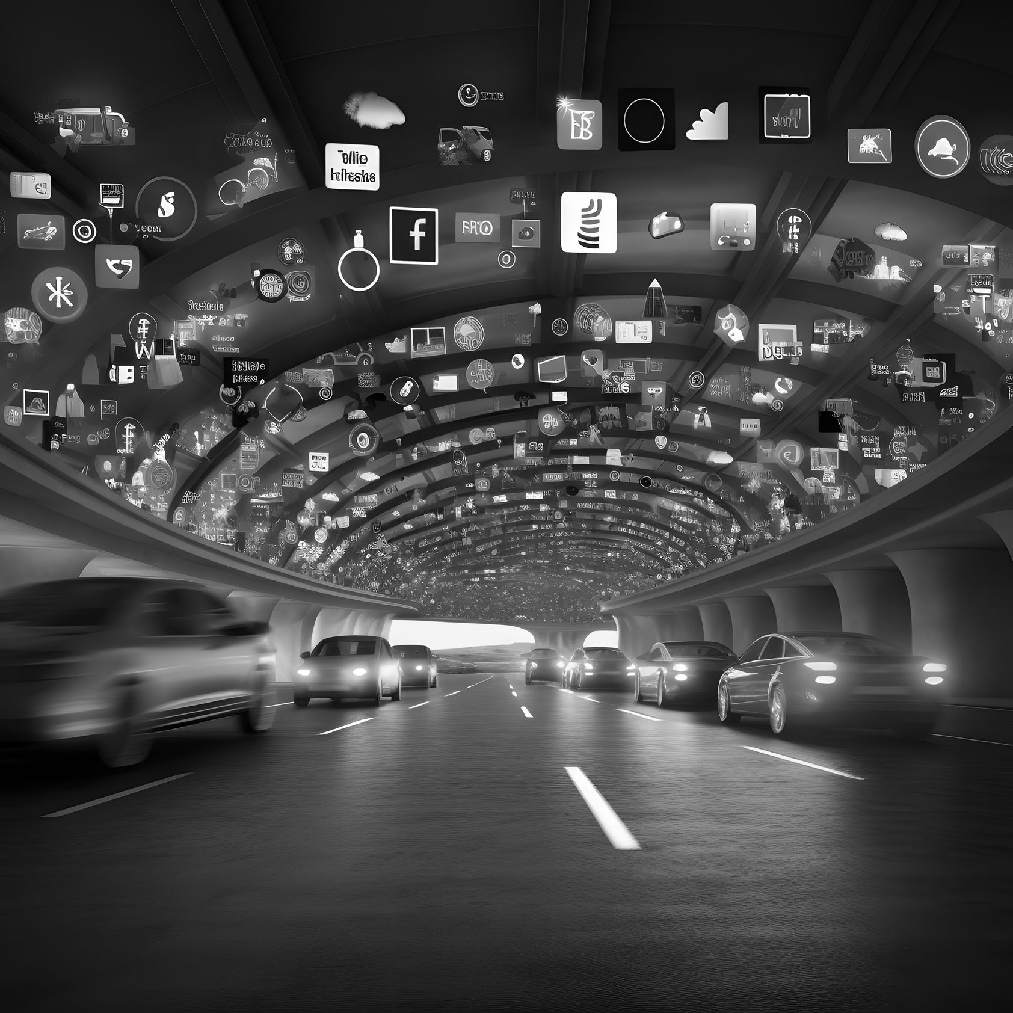
What Deep Learning Really Is
Definition
Key Characteristics
Applications
Deep Learning is a subset of Machine Learning that uses artificial neural networks with multiple layers to automatically learn representations from data. It excels at complex tasks like image recognition and natural language processing.
It works with large amounts of data, uses multiple hidden layers, and excels at complex tasks. Unlike traditional ML, it can automatically extract features from raw data such as images, text, or audio.
Deep Learning is used in image recognition, speech recognition, language translation, autonomous vehicles, and generative AI. It powers technologies like self-driving cars and virtual assistants.

Slide 5



Neural Network Anatomy
01
Components
A neural network consists of neurons, layers, weights, biases, and activation functions. Neurons process input and generate output, while layers extract features from data.
02
Training Process
Training involves backpropagation, where the network adjusts its weights and biases to minimize prediction errors. This iterative learning allows the network to improve over time.
02

Slide 6
02
Core Architectures

Slide 7

CNNs for Computer Vision
Architecture
Key Features
Applications
Impact
Convolutional Neural Networks (CNNs) are designed for image and video processing. They use convolutional layers to capture spatial hierarchies in data.
CNNs employ pooling layers for dimensionality reduction and parameter sharing to preserve spatial structure. This makes them efficient for large datasets.
CNNs are used in object detection for self-driving cars, medical imaging for tumor detection, and facial recognition for security systems.
CNNs have revolutionized computer vision by enabling accurate and efficient image classification and object detection.

Slide 8

RNNs LSTMs and Transformers
Sequential Models
Recurrent Neural Networks (RNNs) and Long Short-Term Memory (LSTM) networks handle sequential data. Transformers use self-attention mechanisms for parallel processing and are ideal for natural language processing tasks.

Slide 9
03
Cross-Domain Wins

Slide 10


Vision and Medical Breakthroughs
Medical Imaging
Security and Agriculture
Deep Learning models in radiology can detect cancers in MRI and CT scans, enabling faster diagnosis and reducing human error.
Real-time security cameras use DL to flag anomalies, while agricultural drones assess crop health, optimizing resource use.

Slide 11


Speech Robotics and Autonomy
01
02
03
Speech Recognition
Robotics
Audio Generation
Speech-to-text technology powers voice assistants like Alexa and Siri, converting spoken words into written text.
Industrial robots use deep learning for complex assembly tasks, while autonomous vehicles detect obstacles and navigate safely.
WaveNet generates realistic human-like speech and music, expanding creative possibilities in audio production.

Slide 12
04
Hands-On Lab

Slide 13
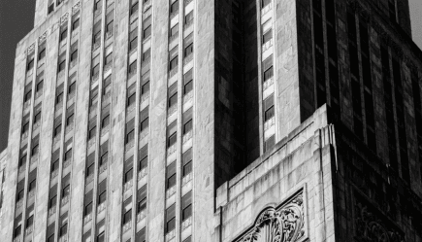


Build Your First CNN Classifier
Setup
Training and Evaluation
Install TensorFlow and Keras, then load the MNIST dataset. Build a simple CNN with convolutional and pooling layers.
Compile the model with an appropriate loss function and optimizer. Train for several epochs and evaluate accuracy on test data.

Slide 14

Text Generation with Transformers
01
02
03
Installation
Usage
Experimentation
Install the Hugging Face Transformers library to access pre-trained models like GPT-2.
Load a pre-trained model and use it for text generation tasks such as sentiment analysis or story creation.
Experiment with different prompts and parameters to generate diverse and creative text outputs.

Slide 15
05
Ethics & Risks

Slide 16
Bias Privacy and Explainability
Ethical Concerns
Deep Learning models can exhibit bias, threaten privacy, and be difficult to interpret. Strategies like fairness metrics and differential privacy help mitigate these issues.

Slide 17
Misuse and Workforce Impact
Misuse Risks
Workforce Impact
Deepfakes and autonomous weapons pose significant risks. Ethical guidelines and regulations are crucial to prevent misuse.
Automation driven by Deep Learning may displace jobs in certain sectors. Reskilling programs and human-in-the-loop strategies can help mitigate this impact.

Slide 18
06
Next Steps

Slide 19

Toolkit Cheat Sheet Recap
Key Tools
Experimentation Platforms
Best Practices
TensorFlow and PyTorch are versatile for research, while Keras simplifies prototyping. Hugging Face Transformers offer easy access to state-of-the-art NLP models.
Runway ML and Google Colab provide zero-setup environments for experimenting with pre-trained models.
Start with pre-trained models, monitor resource usage, and document experiments for reproducibility.

Slide 20


From Demo to Real-World Impact
Next Steps
Stakeholder Feedback
Graduate from basic datasets to custom data, participate in competitions, and collaborate on open-source projects.
Engage with stakeholders to gather feedback and improve model performance.
Ethical Review
Monitoring
Continuous ethical review ensures responsible deployment of Deep Learning models.
Regularly monitor model performance to ensure it remains effective and unbiased over time.

Slide 21


THANK YOU
Sean Wong
2025/08/05

